Slide 1
E1. Two Generals Problem

Slide 2
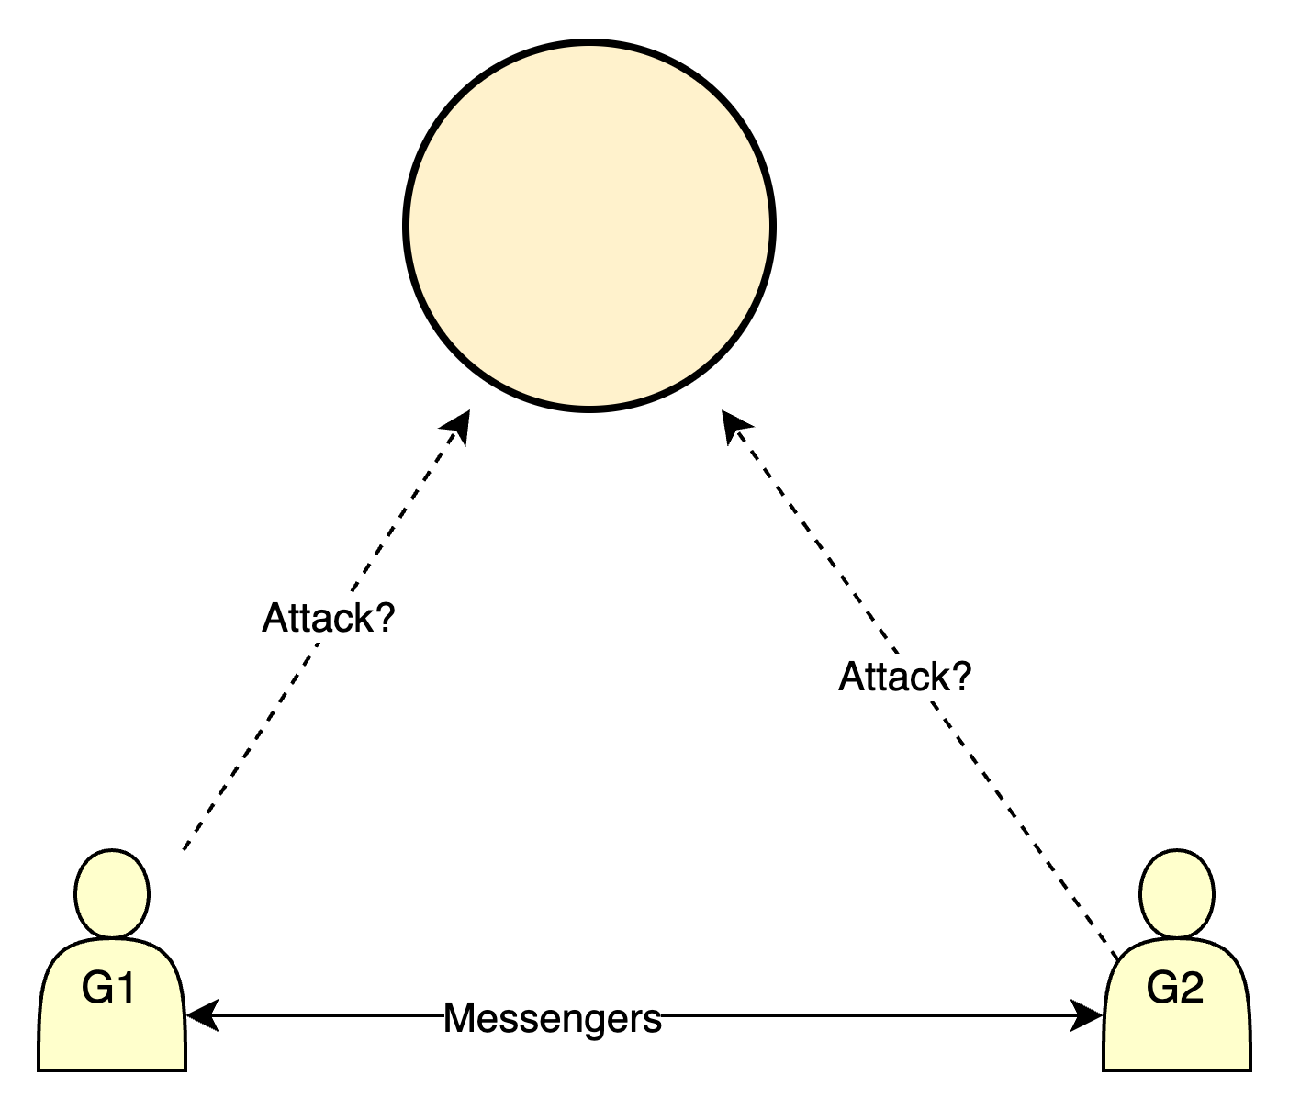
Two General Problem
General 1 | General 2 | Outcome
Does not attack | Does not attack | Nothing happens
Attacks | Does not attack | G1 defeated
Does not attack | Attacks | G2 defeated
Attacks | Attacks | Victory!

Slide 3
The Problem
The decision relies on the messenger which may be captured and not deliver the message.

Slide 4
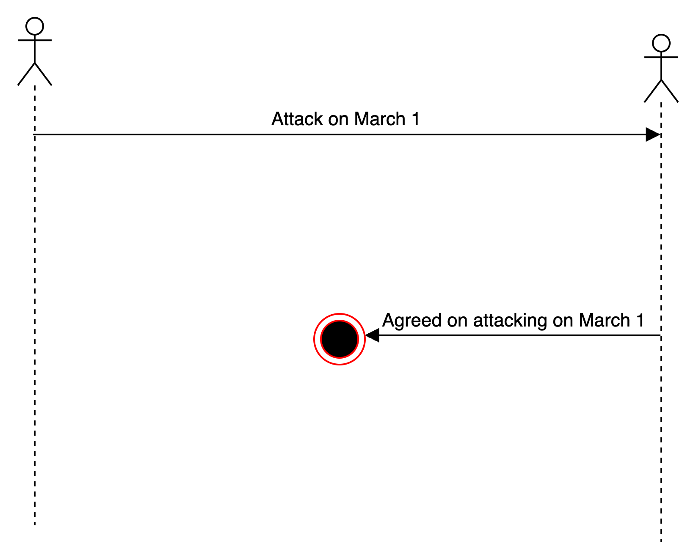
The Problem
The decision relies on the messenger which may be lost and not deliver the message.
Case1:
G1 sends message to G2.
G2 receives the message and agrees, but the response is lost
G2 attacks alone and is defeated.

Slide 5
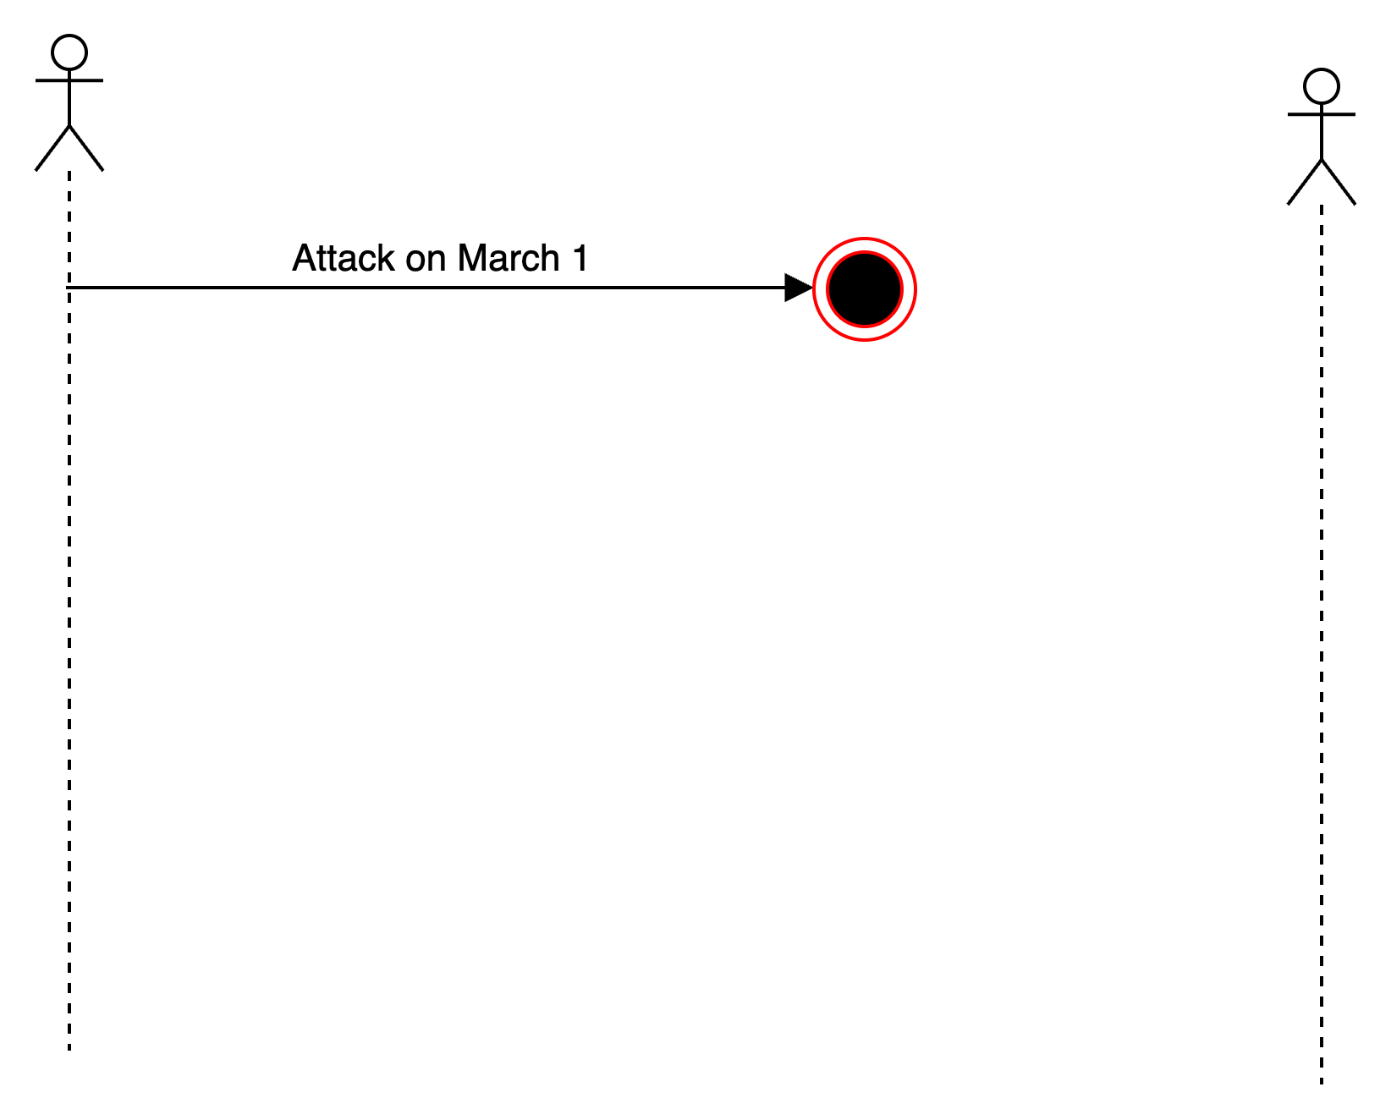
The Problem
From General 1’s point of view these two cases are similar.

Slide 6
Possible Scenarios
General 1 always attacks(even if no response)?
Send lots of messengers to increase the probability that one will get through(to General 2).
If all messengers are captured, General 2 does not know about the attack, so General 1 is defeated.
General 1 only attacks if positive response from General 1 is received?
General 1 is safe.
But General 2 knows that General 1 will attack only if his response gets through.
General 2 is in the same situation as General 1 in previous case. This may lead to infinite chain: Gen 1 sends request , Gen 2 sends response and waits for response that it was received by Gen1, Gen2 sends a message that the response was received, etc.

Slide 7
The Problem
No Common Knowledge: The only way in a distributed system to know something is to communicate it.
Having a chain of any finite length of sending messages between Gen1 and Gen2: 1. Attack, 2. Ack. Attack, 3, Ack. Ack. Attack, 4, Ack. Ack. Ack. Attack,...
there is never absolute certainty that both Generals will attack.

Slide 8
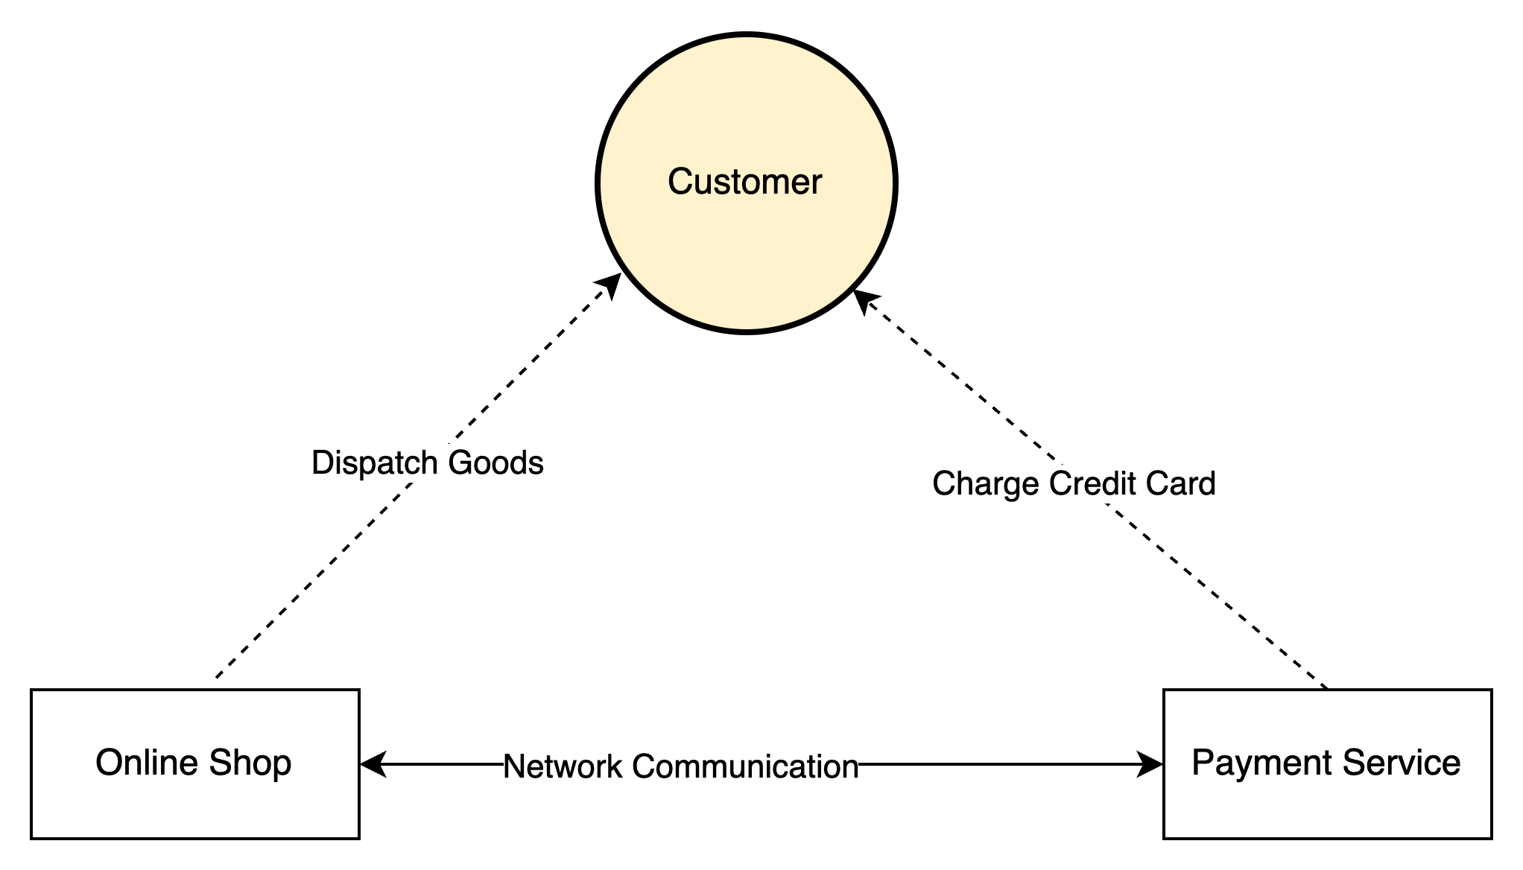
Real World Example
Online Shop | Payments Service | Outcome
Does not dispatch | Does not charge | Nothing happens
Dispatches | Does not charge | Shop loses money
Does not dispatch | Charges | Customer complains
Dispatches | Charges | Everyone Happy!

Slide 9
Solutions
To minimize the chances of money loss from both sides other mechanisms besides communication are usually added,
e.g. charging but after that returning back the money if information comes from the online shop that the order was not delivered.

